Slide 1
AutoAI model building in IBM Wtson Studio.
Building, Evaluating, and Deploying ML Models Automatically
Submitted by – Ishika Sharma
Submitted to – Mr. R Devnath sir

Slide 2
Introduction-
- A feature of IBM Watson Studio
- Automates ML tasks: preprocessing, model selection, training, evaluation
- Speeds up data science workflows
- No code or low code required
-The best pipeline is selected and deployed as a REST API endpoint
Python SDK and API code are provided for easy model integration and testing

Slide 3
Project Overview-
- Objective: Automatically build the best-performing ML model
- Tool: IBM Watson Studio AutoAI
- Dataset Used: e.g., salary_test.csv , salary_train.csv
- Prediction Goal: to forecast an individual’s salary (typically “Yearly Salary”)

Slide 4
Steps Involved
1. Create IBM Watson Studio project
2. Upload dataset
3. Create AutoAI experiment
4. Select target column
5. Run AutoAI pipeline
6. Evaluate & deploy model
7. Test via API or Python SDK

Slide 5
Data Upload -
- Uploaded dataset to Watson Studio (CSV file)
- Sample columns: education ,expertise, industry , location, Company , certifications , age , salary.
- Selected "salary" as prediction target.

Slide 6
AutoAI Pipeline
- AutoAI automatically performed:
- Data cleaning
- Feature engineering
- Model selection
- Hyperparameter tuning
- Tested models:
- Logistic Regression
- XGBoost
- LightGBM

Slide 7
Model Evaluation
- Best pipeline: Pipeline_3 (LightGBM)
- Accuracy: 87%
- ROC AUC: 0.89
- Selected based on highest performance metric
- AutoAI provided full pipeline steps

Slide 8
Deployment
- Model saved & deployed using Online Deployment
- API endpoint generated
- Ready to integrate into apps or scripts
- Deployment platform: IBM Watson Machine Learning (WML)

Slide 9
Python Code Access
- AutoAI provided:
- Google colab Notebook
- Python SDK code
- REST API code
-Enables further customization and automation

Slide 10
Project Benefits
- Fully automated ML
- No manual preprocessing or tuning
- Scalable & Reproducible
- Accessible for beginners

Slide 11
Summary
- AutoAI helps build the reliable ML models faster
- Saves time, ensures consistency
- Easy deployment and integration
- Ideal for data-driven projects

Slide 12
References
- IBM Watson Studio Docs
- AutoAI Documentation
- IBM Cloud Console

Slide 13
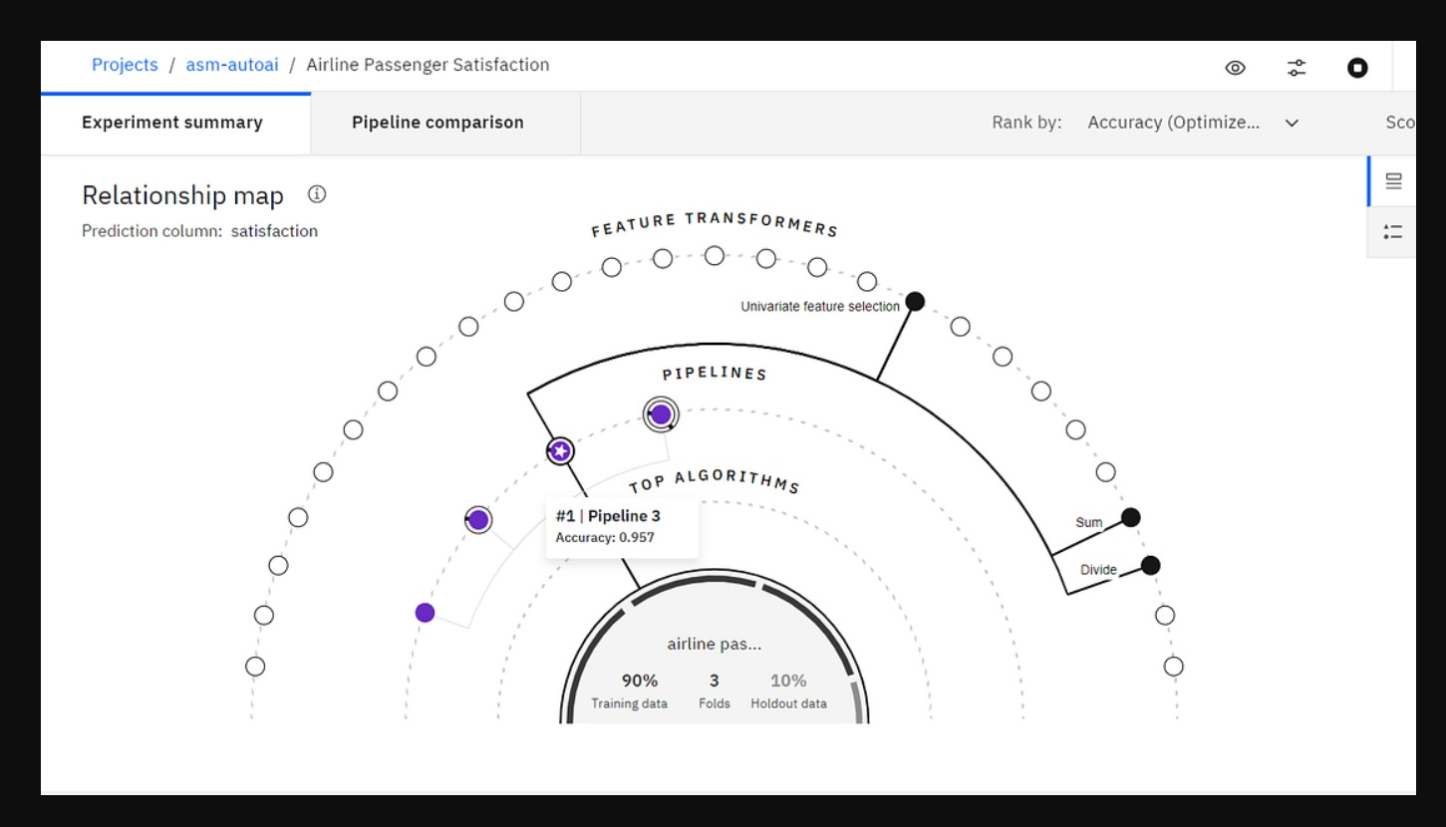
Best pipeline selected:

Slide 14
Thank you

